Slide 1

Quick recap
What’s the most important characteristic of a (process) model?
What are the typical uses of process models?
What are the core elements of BPMN?

Slide 2
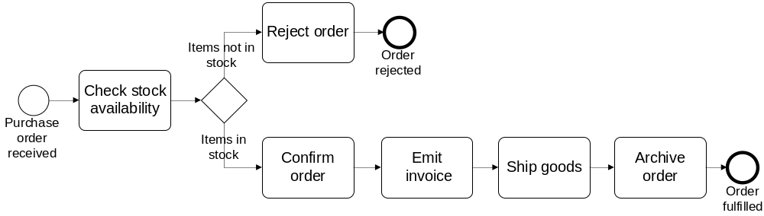
Let’s reconsider our order-to-cash example
  […] If the purchase order is confirmed, an invoice is emitted and the goods requested are shipped. The process completes by archiving the order. […]
  an invoice is emitted and the goods requested are shipped.

Slide 3
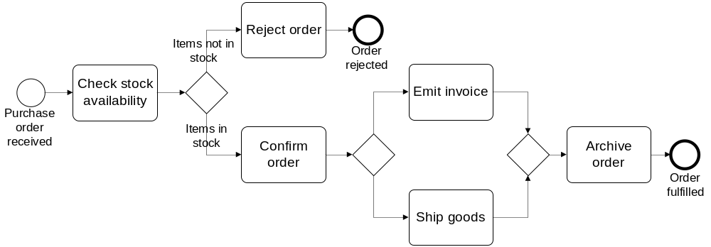
Solution
Order-to-cash
split
split
join

Slide 4

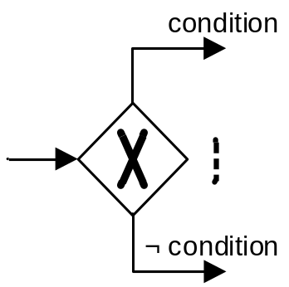
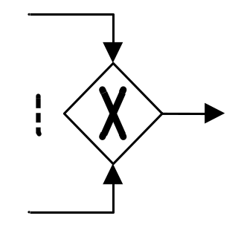
A little more on gateways: XOR Gateway
  An XOR Gateway captures decision points (XOR-split) and points where alternative flows are merged (XOR-join)
  XOR-split ➔ takes one outgoing branch
  XOR-join ➔ proceeds when one incoming branch has completed

Slide 5
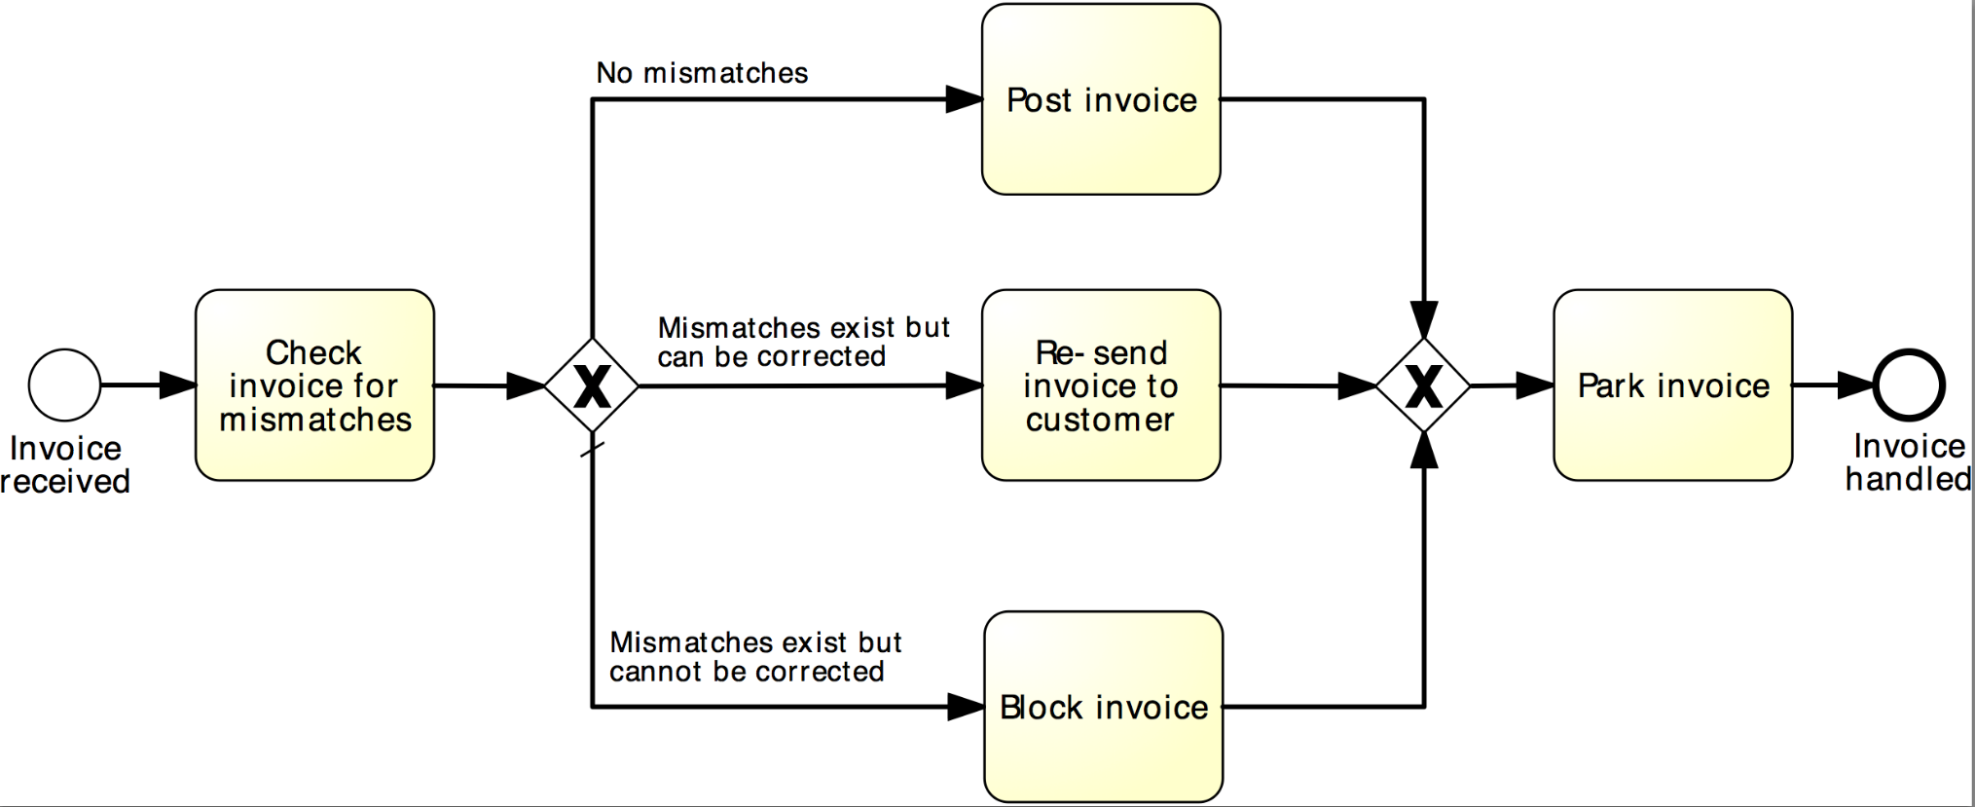
Example: XOR Gateway
Invoice checking process

Slide 6

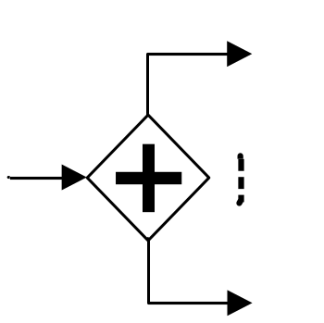
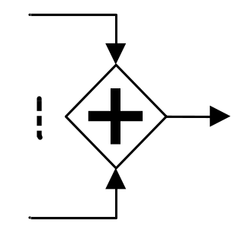
A little more on gateways: AND Gateway
  An AND Gateway provides a mechanism to create and synchronize “parallel” flows.
  AND-split ➔ takes all outgoing branches
  AND-join ➔ proceeds when all incoming branches have completed

Slide 7
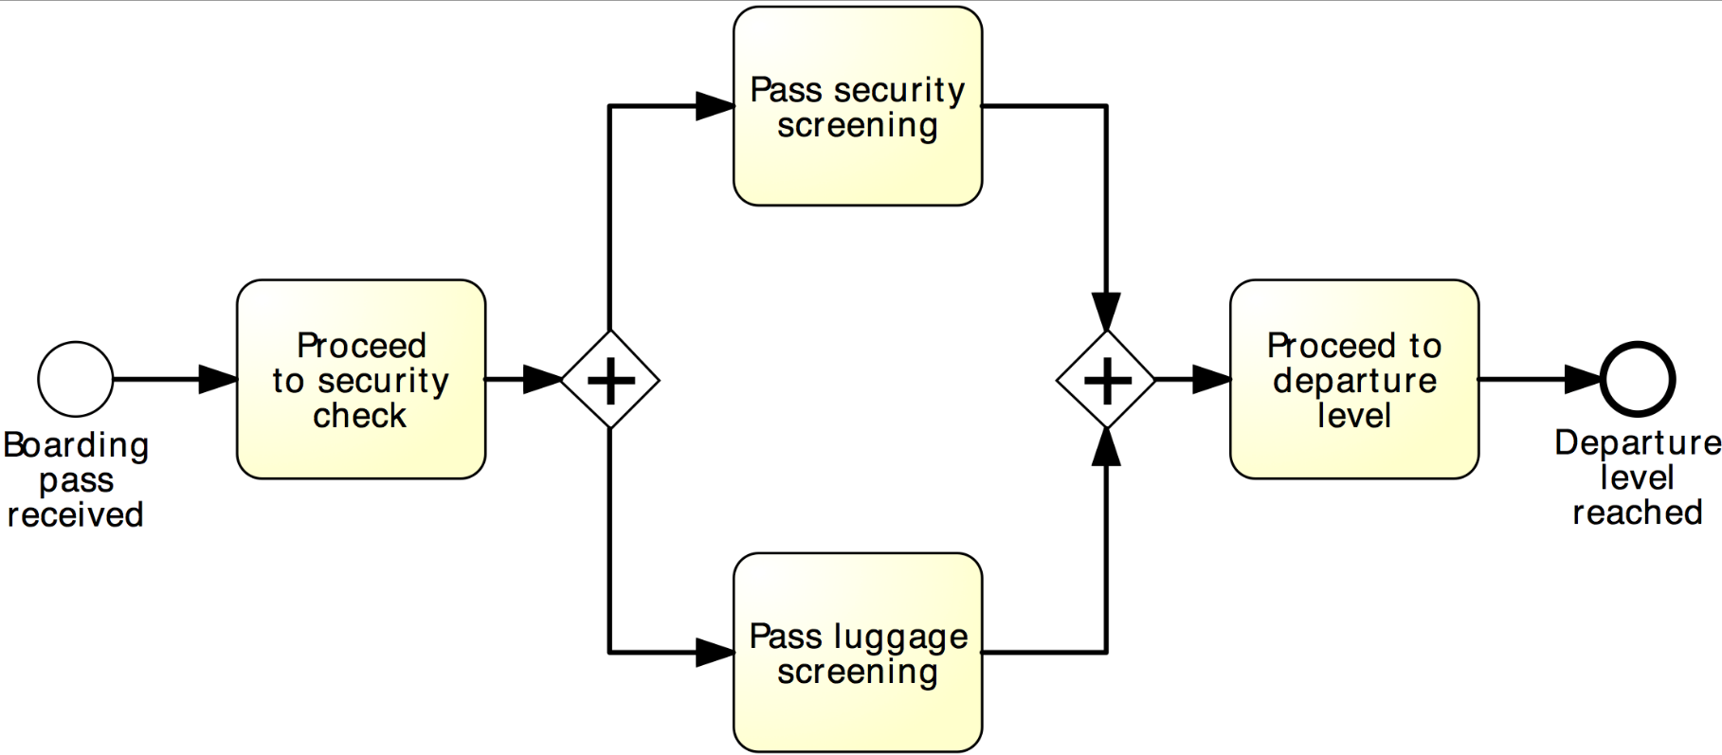
Example: AND Gateway
Airport security check

Slide 8
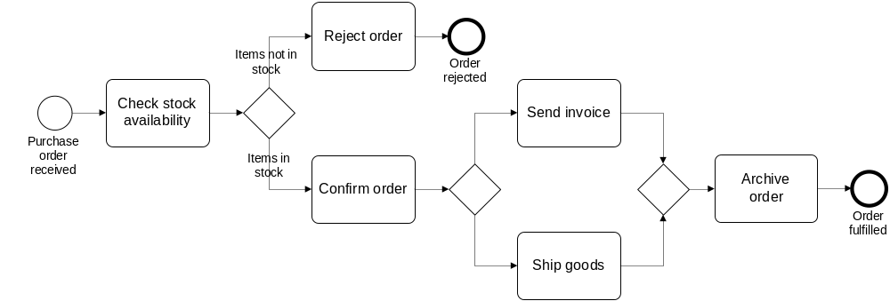

Revised solution
Order-to-cash
XOR-split
AND-split
AND-join

Slide 9
XOR / AND are not always what we need...
Order distribution process
A company has two warehouses, one in Amsterdam, the other in Hamburg, that store different products. When an order is received, it is distributed across these warehouses: if some of the relevant products are maintained in Amsterdam, a sub-order is sent there; likewise, if some relevant products are maintained in Hamburg, a sub-order is sent there. Afterwards, the order is registered and the process completes.

Slide 10
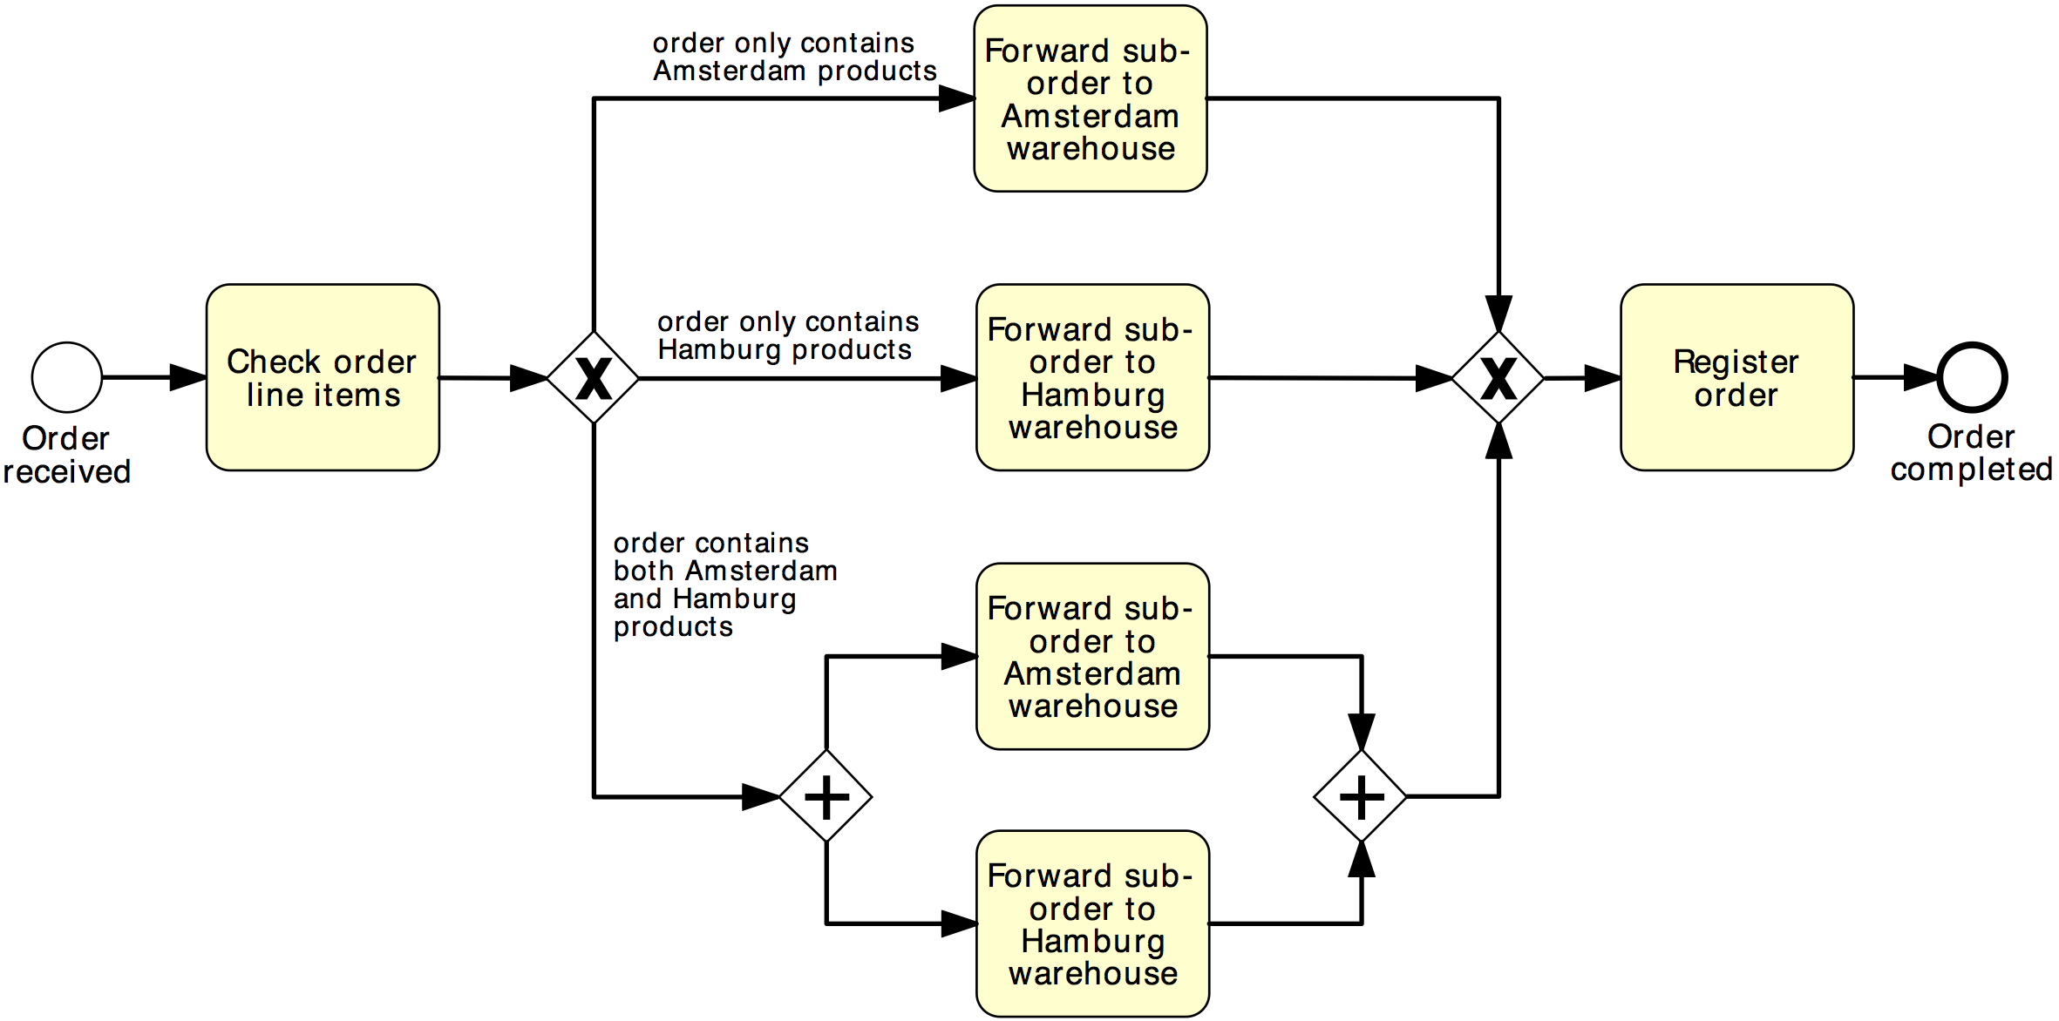
Solution 1
Order distribution process
XOR-split
XOR-join
AND-split
AND-join

Slide 11
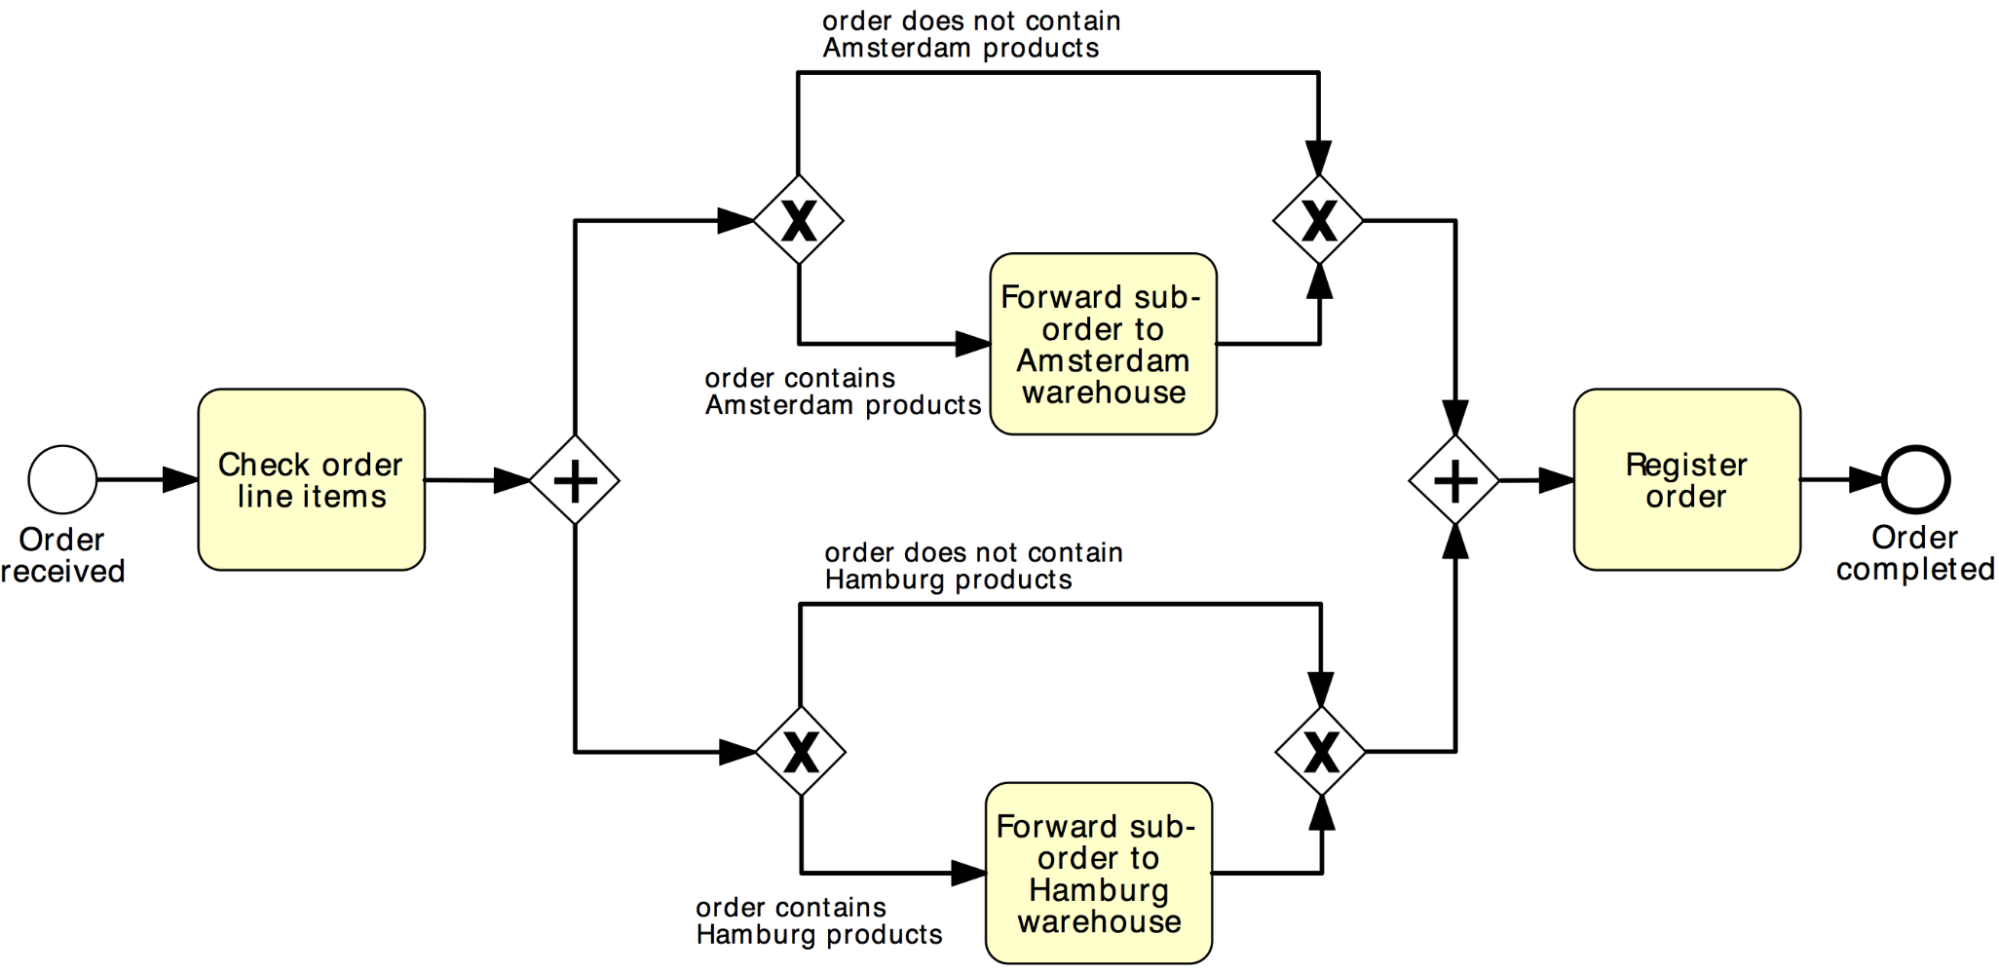
Solution 2
Order distribution process
AND-split
AND-join
XOR-split
XOR-join

Slide 12

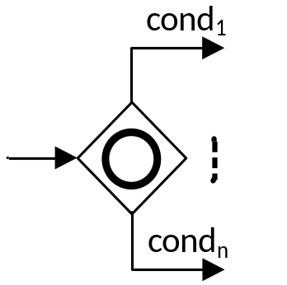
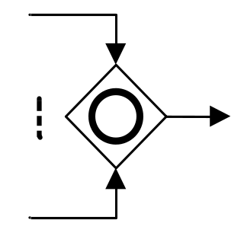
OR Gateway
  An OR Gateway provides a mechanism to create and synchronize n out of m parallel flows.
OR-split ➔ takes one or more branches depending on conditions
OR-join ➔ proceeds when all active incoming branches have completed

Slide 13
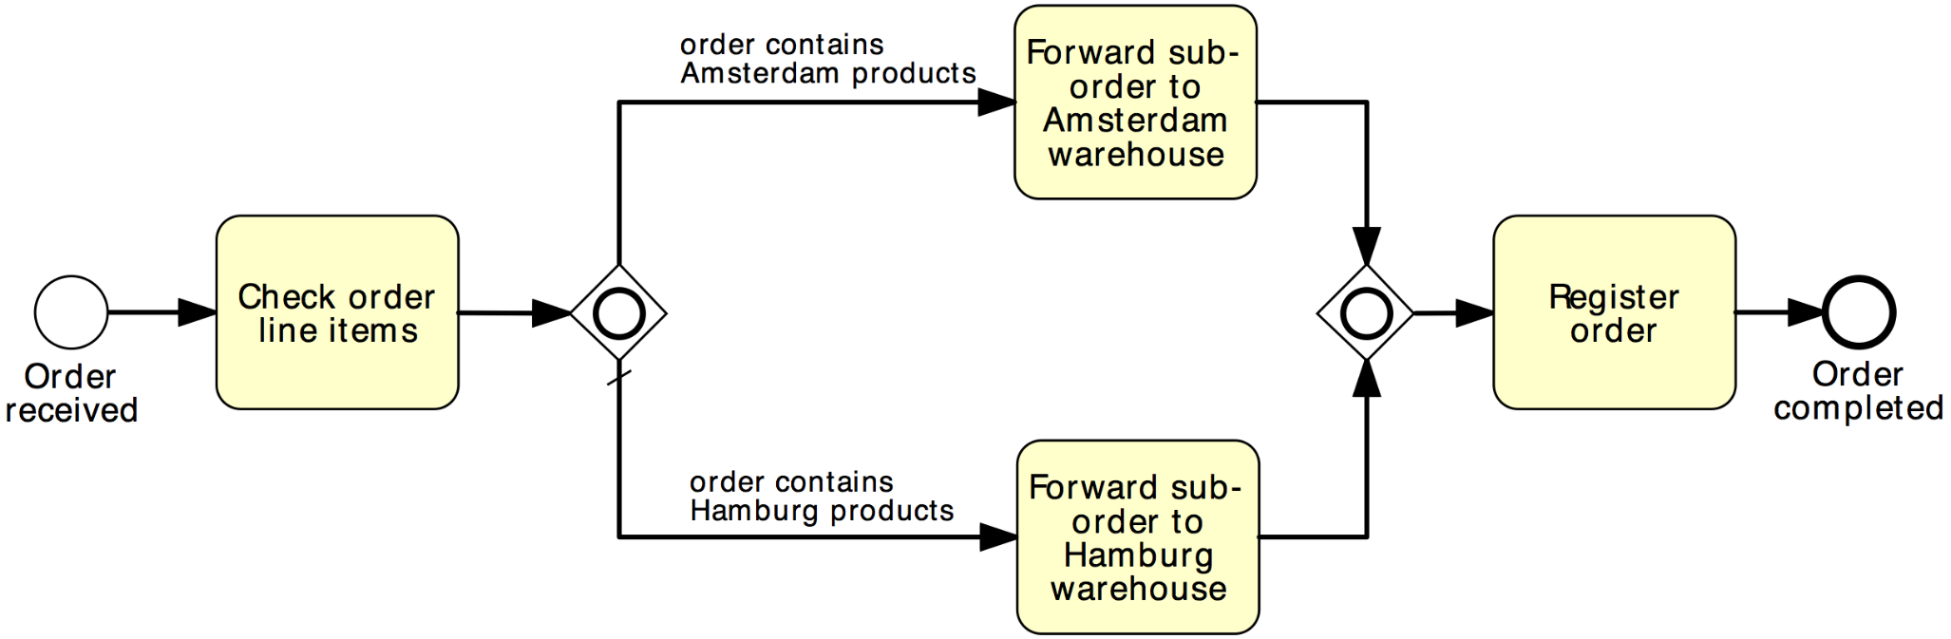
Solution using OR Gateway
Order distribution process
OR-split
OR-join

Slide 14
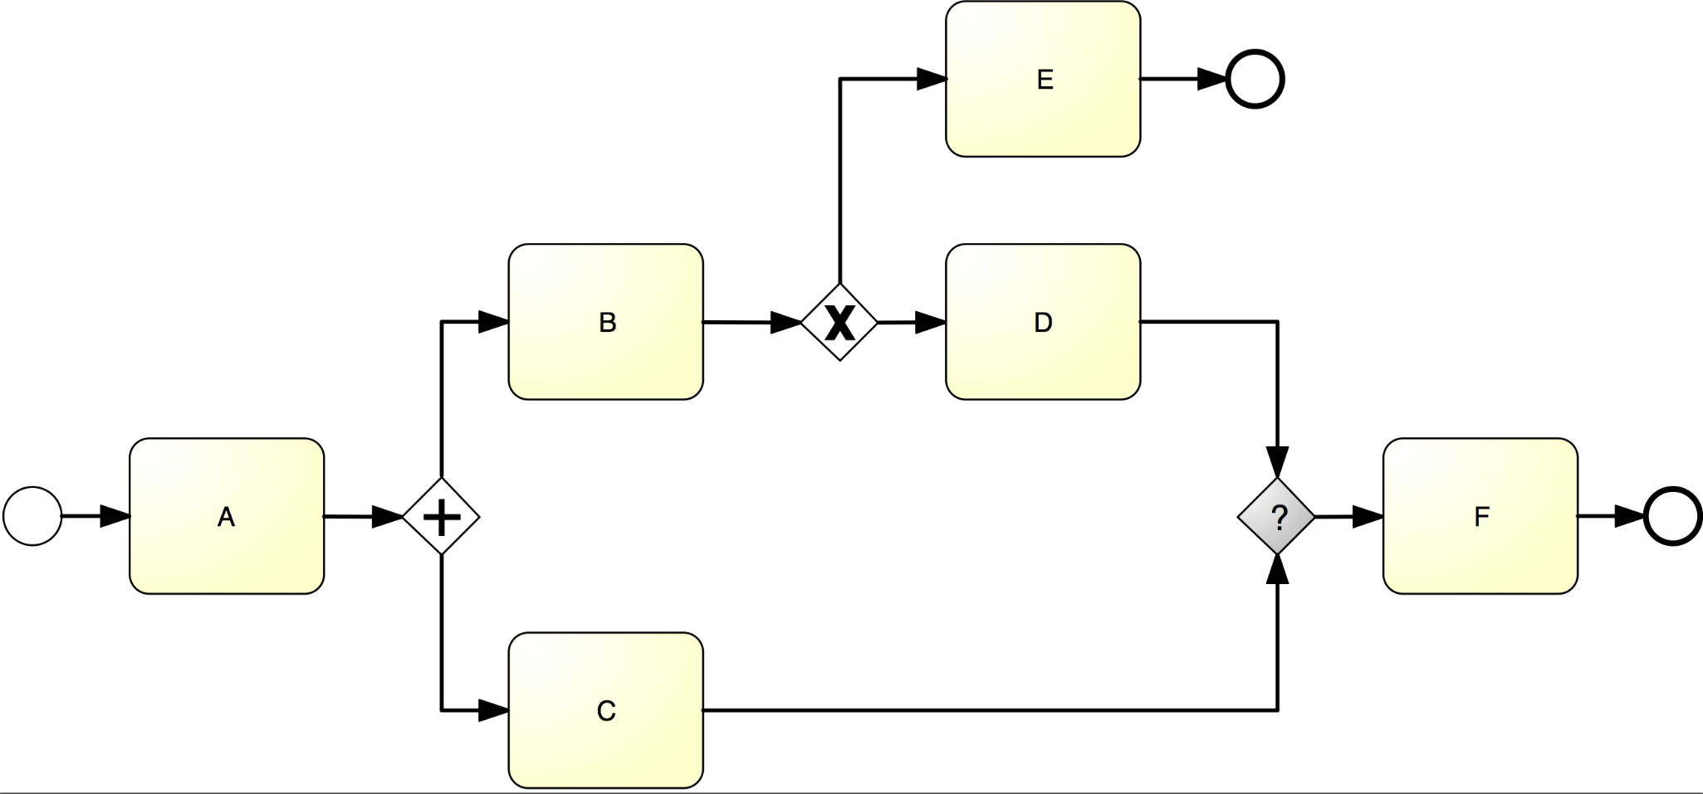

What join type do we need here?

Slide 15
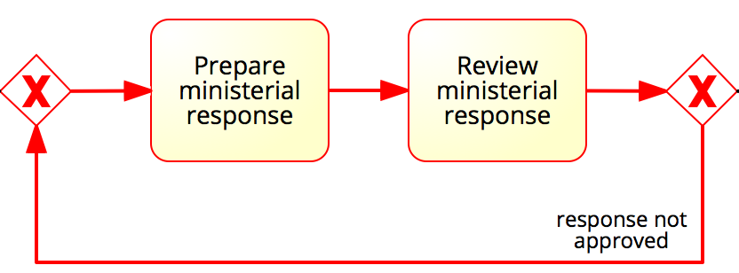
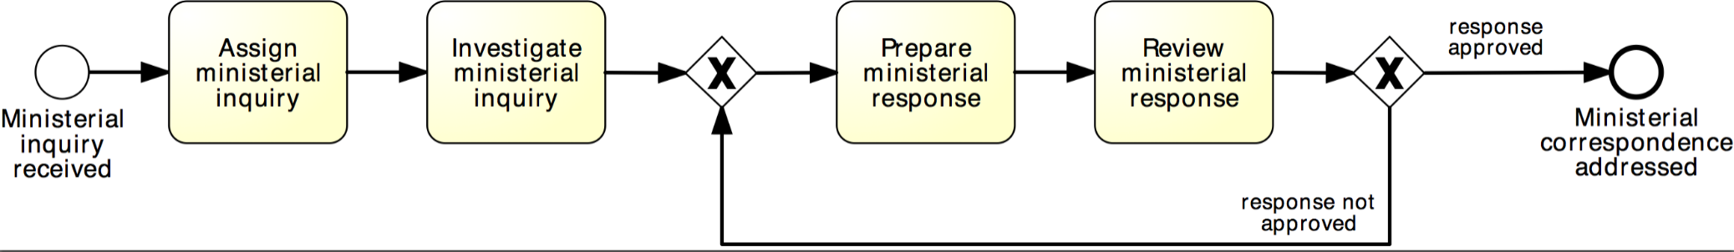
Rework and repetition
Address ministerial correspondence
In the treasury minister’s office, once a ministerial inquiry has been received, it is registered into the system. Then the inquiry is investigated so that a ministerial response can be prepared.
The finalization of a response includes the preparation of the response itself by the cabinet officer and the review of the response by the principal registrar. If the registrar does not approve the response, the latter needs to be prepared again by the cabinet officer for review. The process finishes only once the response has been approved.
XOR-join: entry point
XOR-split: exit point

Slide 16
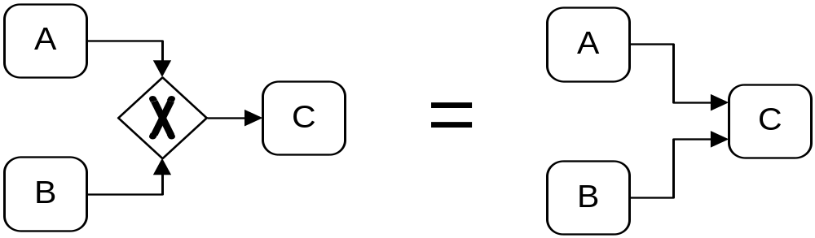
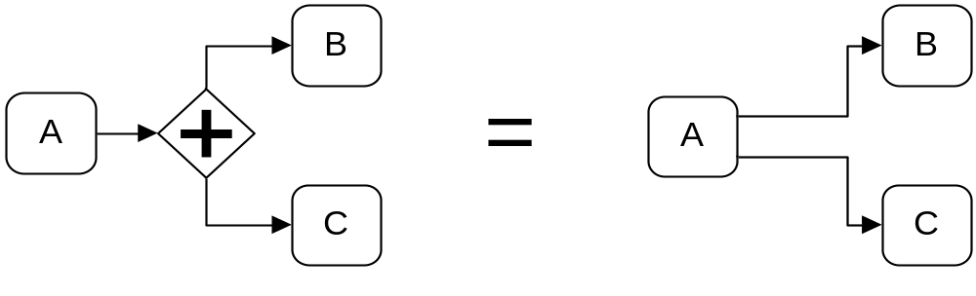
Implicit vs. explicit gateways

Slide 17
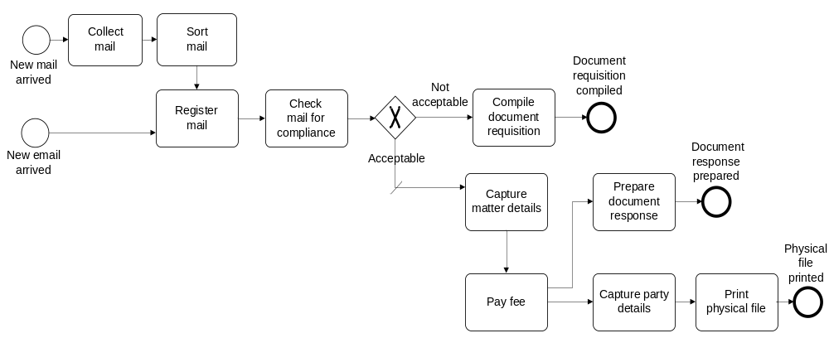
What’s this process doing?

Slide 18
What’s needed to create a model?

Slide 19
What’s needed to create a model?
Modelling Language
Vocabulary
Syntax
Semantics
Notation
Model
Modelling Conventions
Modelling Tool

Slide 20

Modelling Language: Syntax
from Ancient Greek συν- (syn-), "together", and τάξις (táxis), "arrangement”
Provides the constructs and the set of rules to combine these constructs
E.g. in English grammar: “The present perfect of any verb is composed of two elements: the appropriate form of the auxiliary verb to have (present tense), plus the past participle of the main verb.”
“I have enrolled in a unit.”
“I has enrolled in a unit”.
Aim: Syntactical correctness

Slide 21

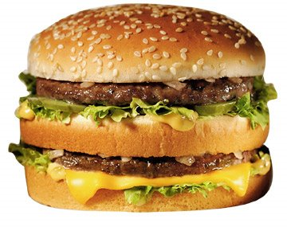
Modelling Language: Semantics
from ancient Greek σημαντικός (semantikos), "significant", from σημαίνω (semaino), "to signify, to indicate" and that from σήμα (sema), "sign, mark, token".
The study of meaning, and the study of relations between different elements.
Aim: semantical correctness
=

Slide 22
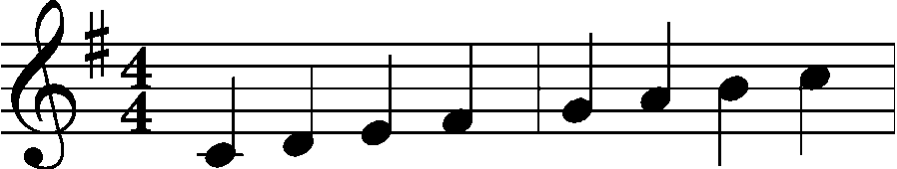
Modelling Language: Notation
Defines a set of symbols for the visualisation of the constructs and their relationships
Textual symbols: E E E E E E E E E E E E
Graphical symbols:
Alternative symbols can refer to the same construct
(redundancy)
The same symbol sometimes refers to different constructs (overload)

Slide 23
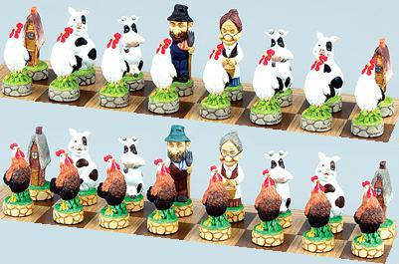


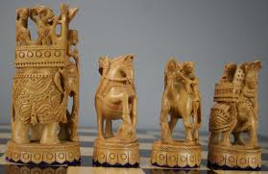
Example: Chess

Slide 24
In BPMN?
Vocabulary
Activities, Events, Gateways, Sequence Flow…
Structural correctness
individual rules for each element are complied with:
  activities must have at least one incoming and one outgoing sequence flow
  start events must not have incoming arcs, end events must not have outgoing arcs
  gateways must have exactly one incoming and at least two outgoing arcs (splits) or at least two incoming and exactly one outgoing arcs (joins)
all nodes are on a path from a start to an end event (i.e. no dangling arcs or disconnected nodes)
  implies that a model should have at least one start and one end event

Slide 25
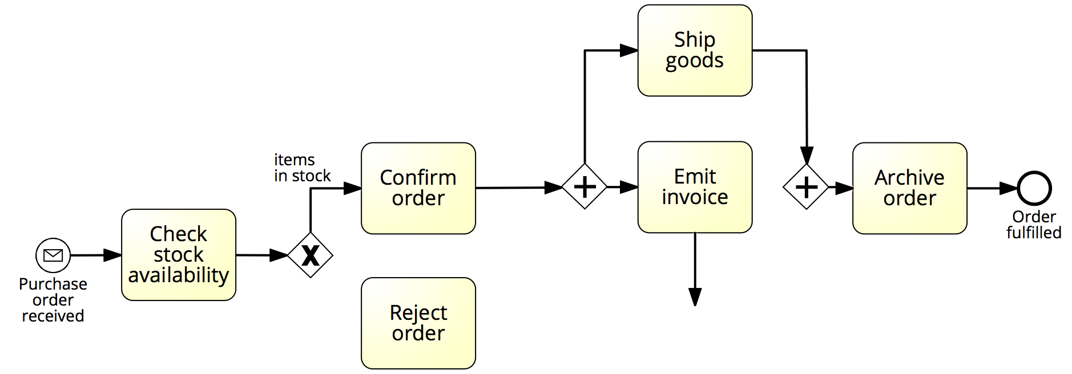
Example: structural correctness

Slide 26
In BPMN?
Behavioral correctness (a.k.a. soundness)
option to complete: any running process instance must eventually complete, i.e. there are no deadlocks or livelocks
proper completion: at the moment of completion, each token of the process instance should be in a different end event, i.e. there is no lack of synchronization, and
no dead activities: any activity can be executed in at least one process instance.

Slide 27
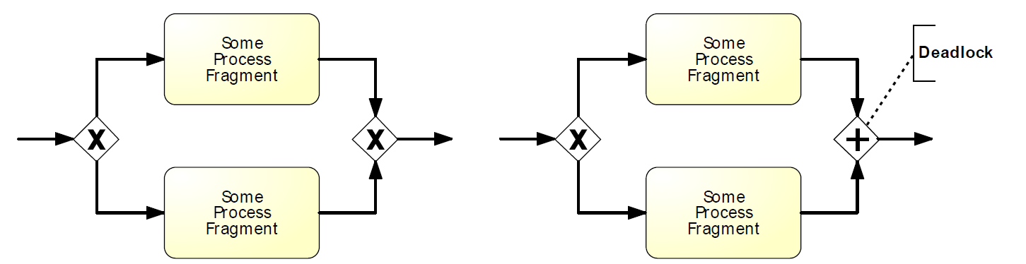
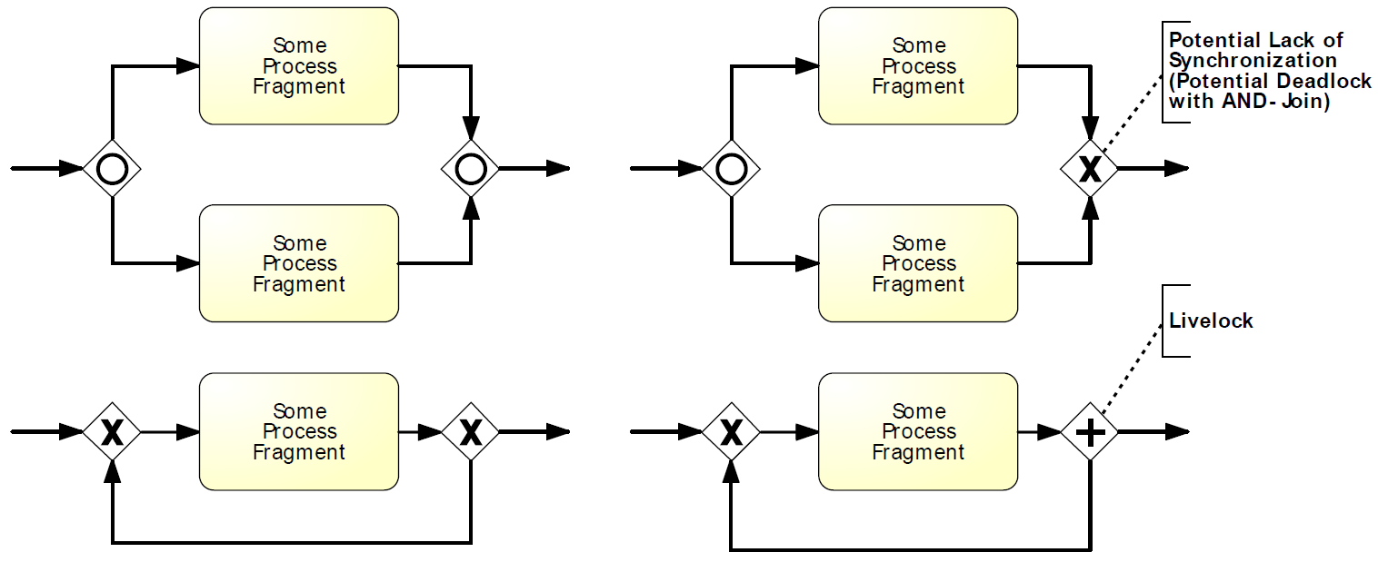
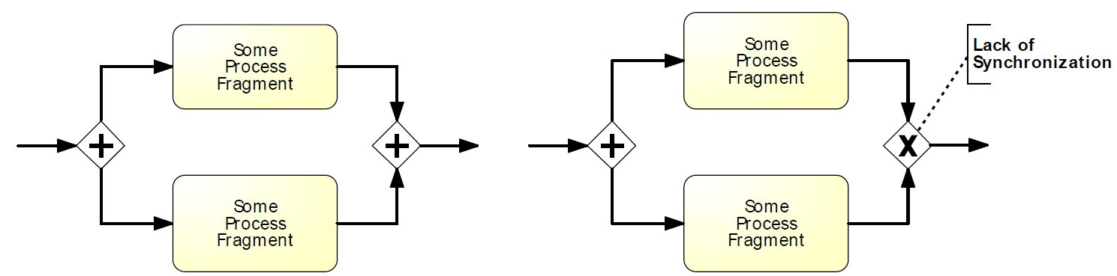
Behavioral correctness: cheat sheet
No option to complete
No option to complete
No proper completion
No proper completion/
No option to complete

Slide 28
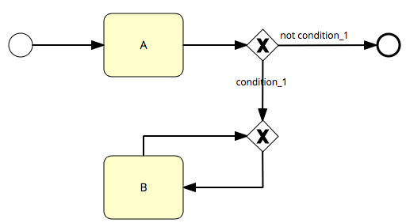
Example: no option to complete
If condition_1 is true, the instance cannot complete and activity B will be repeated forever (livelock)

Slide 29
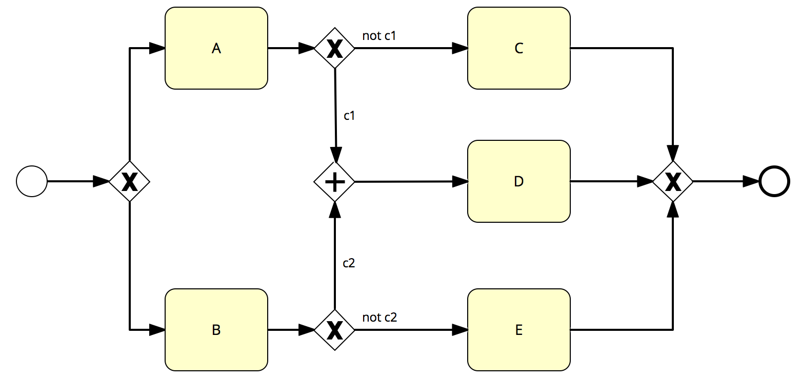
Example: no option to complete
If c1 is true after executing A, or c2 is true after executing B, the instance cannot complete (deadlock)
Note: this model also suffers from a dead activity (D)

Slide 30
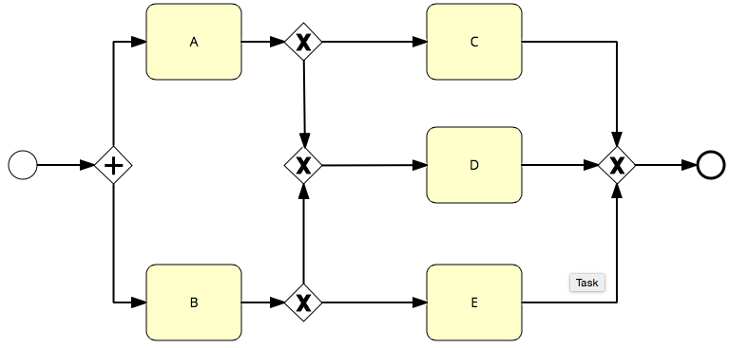
Example: no proper completion
At the moment of completion, there will be two tokens in the end event (lack of synchronization)

Slide 31

Example: dead activity
Even if this model can always complete, Activity D will never be executed
Note: this model also suffers from lack of synchronization, as a token will be left behind
(stuck before the AND-join) when the end event is reached

Slide 32
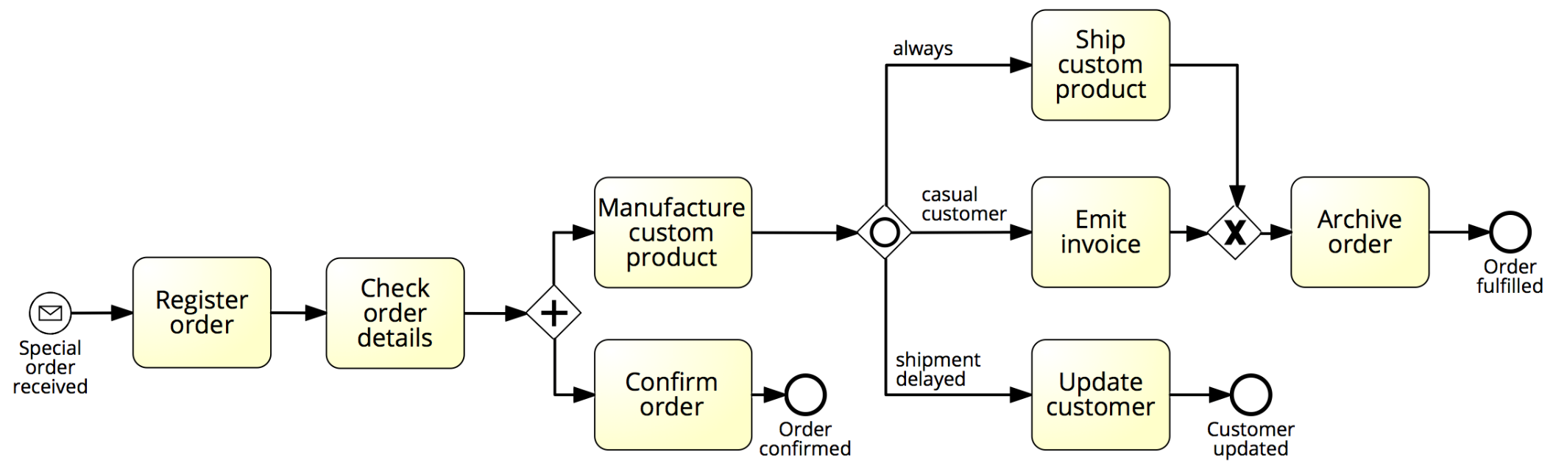
Example: behavioral correctness
Fulfilment of special orders

Slide 33
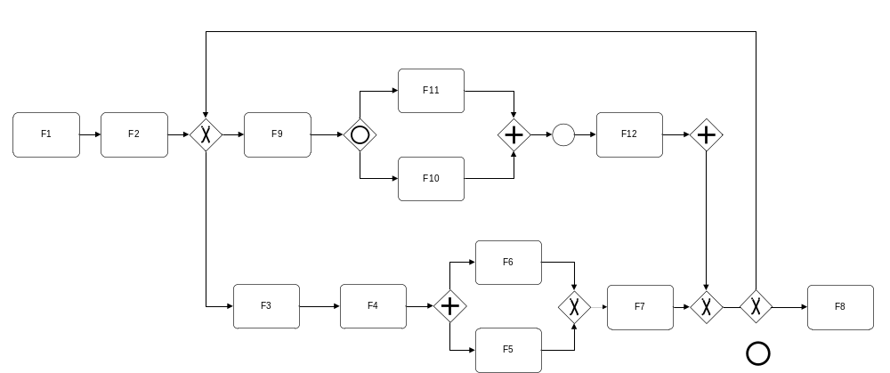
Find the bugs…
Trivial Gateway
No Start Event
What??
Split or Join?
May deadlock
No End Event
Lack of
synchronization
Disconnected node

Slide 34




In BPMN?
Semantics
Meaning of the various elements
  Activities model something actively performed during the process
  Events model something instantaneous during the process
  AND gateways model parallelism
  XOR gateways model exclusive decisions and simple merging points
  OR gateways model inclusive decisions and synchronizing merging points
Meaning of the whole business process model
  This model captures an order fulfilment process that takes place at a seller. The model starts with the receipt of an order…
Notation

Slide 35
Example: semantic correctness
Order distribution process
Invalid
It is not possible that products are neither in the Amsterdam nor in the Hamburg warehouse.

Slide 36
What’s needed to create a model?
Modelling Language
Vocabulary
Syntax
Semantics
Notation
Model
Modelling Conventions
Modelling Tool

Slide 37
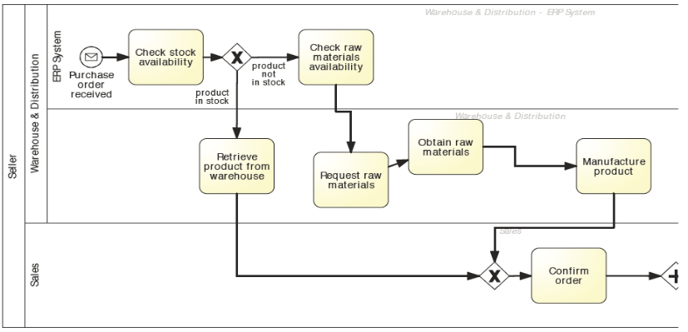
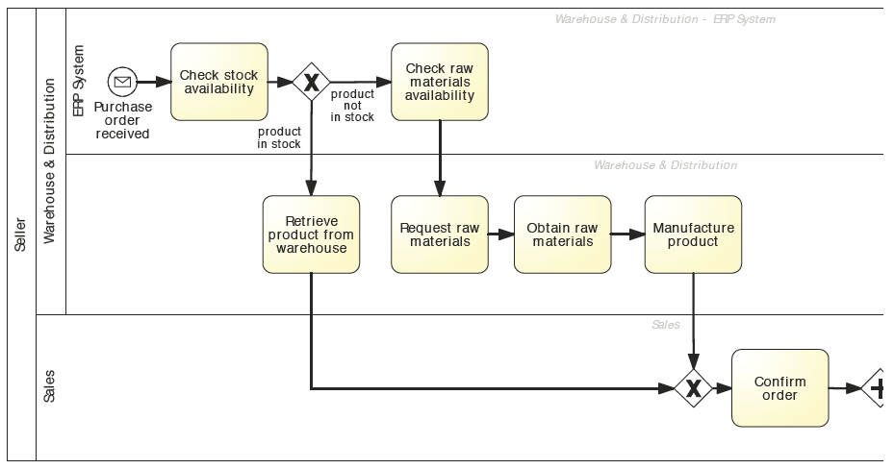
Modeling conventions
Labeling
Activities as imperative verb + noun
Events as noun + past-participle verb
Conditions on outgoing arcs of (X)OR-splits with reference to object
Layout
From top-left to bottom-right
Use direct arcs with no crossing where possible

Slide 38
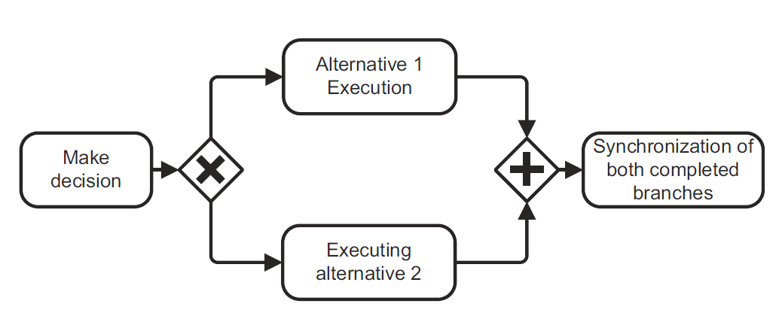

Is this process model of good quality?
Different labeling styles

Slide 39
What’s needed to create a model?
Modelling Language
Vocabulary
Syntax
Semantics
Notation
Model
Modelling Conventions
Modelling Tool

Slide 40
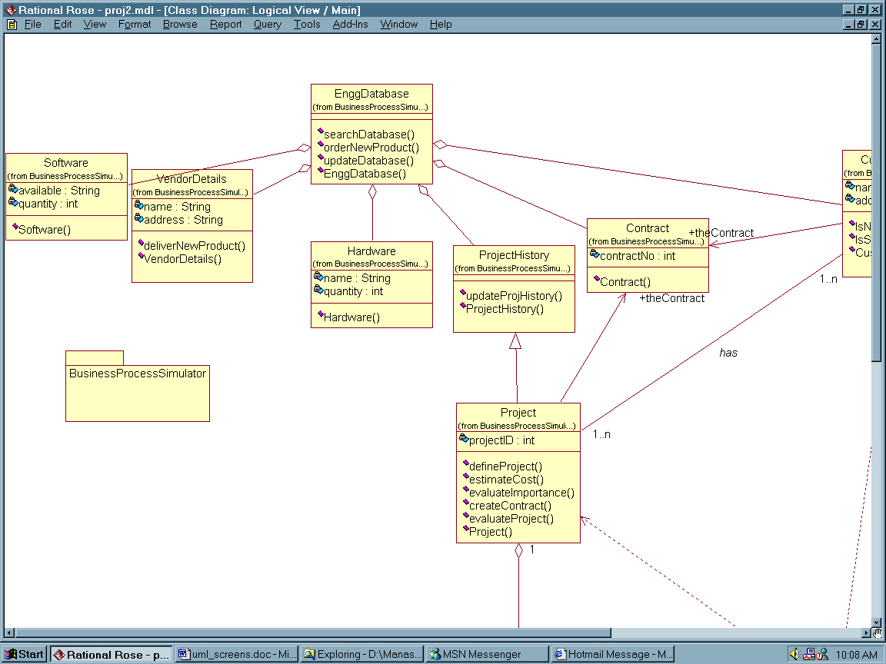
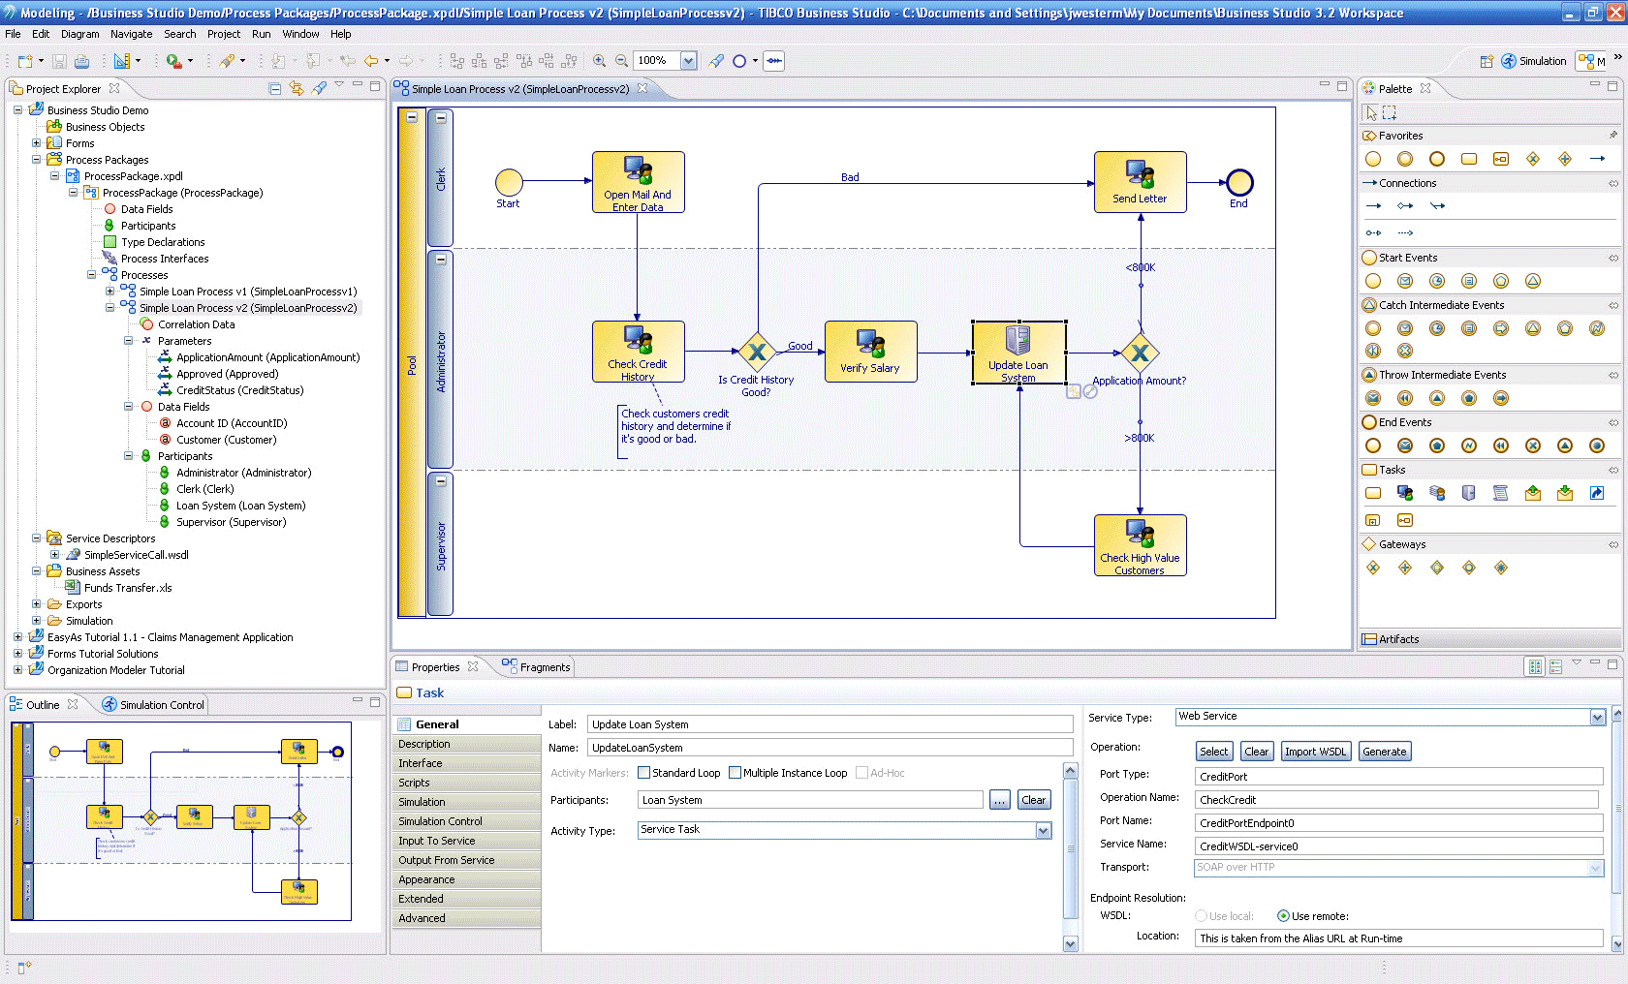
Process Modelling Tools
General-purpose graphical design tools
  E.g Visio, Powerpoint
Software Engineering tools (CASE)
  E.g. Rational Rose
Enterprise Architecture tools
  E.g. System Architect
Dedicated business process modeling tools
  E.g. ARIS, Signavio
Design tools as part of a BPMS
  E.g. IBM Process Designer, Oracle JDeveloper, Bizagi Modeler

Slide 41
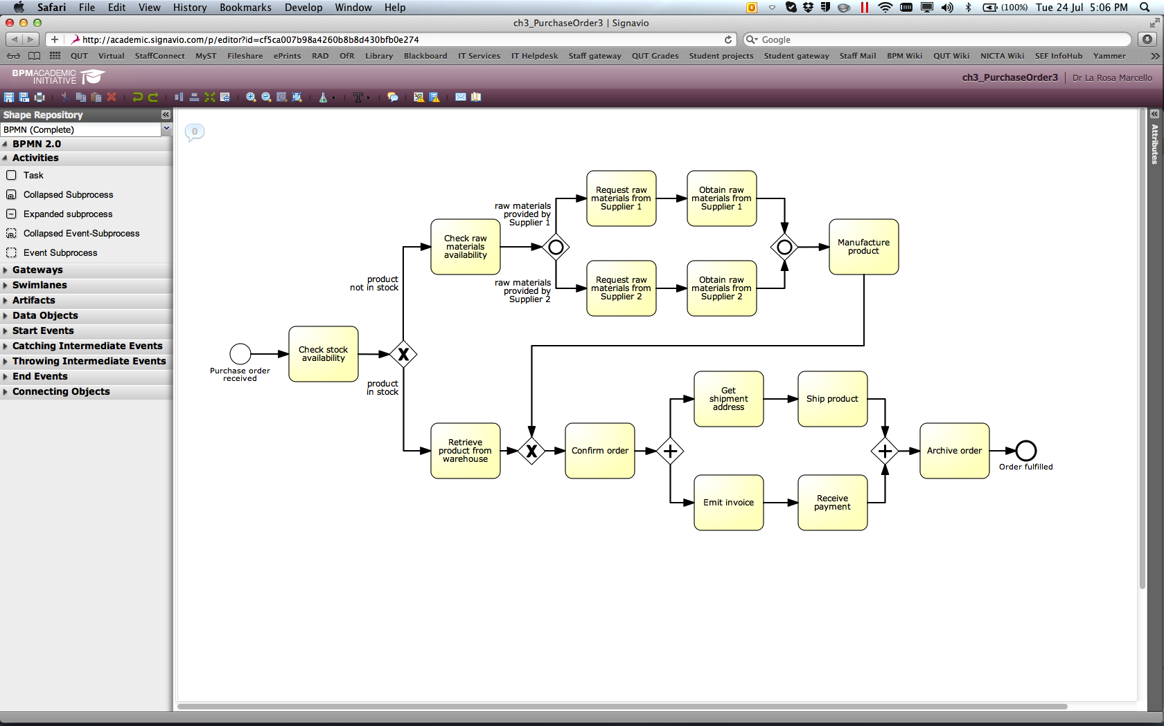
Our modelling tool: Signavio
Check out Signavio documentation on blackboard
Register for a free trial account

Slide 42

Readings for Week 3
Required
Dumas M., La Rosa M., Mendling J., Reijers, H. (2013):
Fundamentals of BPM. Section 3.2 of Chapter 3
J. Mendling, H.A. Reijers, W.M.P. van der Aalst, Seven process modeling guidelines (7PMG). Information and Software Technology, 52(2), 2010
J. Becker, M. Rosemann, C. von Uthmann: Guidelines of business process modeling. Proceedings of Business Process Management, LNCS 1806, 2000
M. Rosemann, Potential pitfalls of process modeling: Part A and B. Business Process Management Journal, 12(2-3), 2006
Recommended

